Slide 1
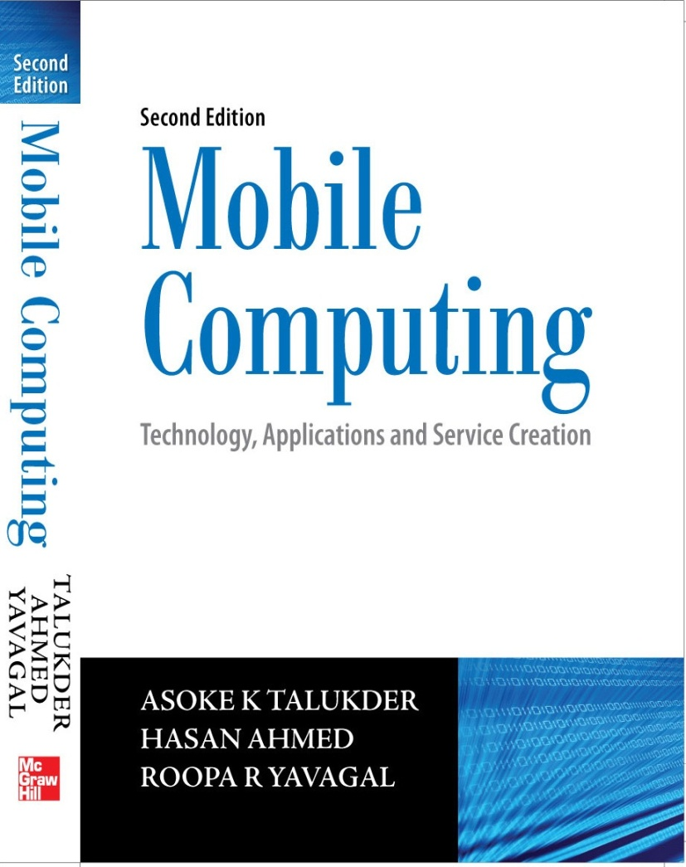
Notes#4
Emerging Technologies

Slide 2
Emerging Technologies
Bluetooth
Radio Frequency Identification (RFID)
WiMAX
Mobile IP
IPv6
Java Card

Slide 3
Bluetooth
Name comes from nickname of Danish king Harald Blåtand
Allows users to make ad hoc wireless connections between devices like mobile phones, desktop or notebook computers wirelessly
Data transfer at a speed of about 720 Kbps within 50 meters (150 feet) of range or beyond through walls, clothing and even luggage bags
Built into a small microchip
Operates in a globally available frequency band ensuring worldwide interoperability
Managed and maintained by Bluetooth Special Interest Group

Slide 4
Bluetooth Protocol
Uses the unlicensed 2.4 GHz ISM (Industrial Scientific and Medical) frequency band
79 available channels spaced 1 MHz apart from 2.402 GHz to 2.480 GHz
Allows power levels starting from 1mW (covering 10 centimetres) to 100mW (covering upto 100 meters) suitable for short device zone to personal area networks within a home
Supports both unicast (point-to-point) and multicast (point-to-multipoint) connections
Bluetooth protocols are a collection of many inter-related protocols

Slide 5
Bluetooth Protocol
Uses the master and slave relationship
Master and slaves together form a Piconet when master allows slaves to talk
Up to seven ‘slave’ devices can be set to communicate with a ‘master’ in a Piconet
Scatternet is formed when several of piconets are linked together to form a larger network in an ad hoc manner

Slide 6
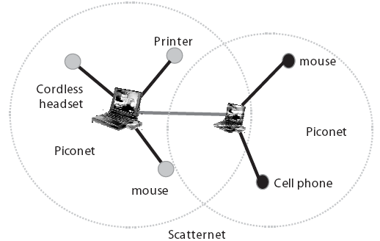
Bluetooth Protocol
Scatternet is a topology where a device from one piconet also acts as a member of another piconet wherein a device being a master in one piconet can simultaneously be a slave in the other one

Slide 7
Bluetooth Protocol
Bluetooth Core protocols plus Bluetooth radio protocols are required by most of Bluetooth devices
Uses spread spectrum technologies at the Physical Layer while using both direct sequence and frequency hopping spread spectrum technologies
Uses connectionless (ACL–Asynchronous Connectionless Link) and connection-oriented (SCO–Synchronous Connection-oriented Link) links
Cable Replacement layer, Telephony Control layer and Adopted protocol layer form application-oriented protocols

Slide 8
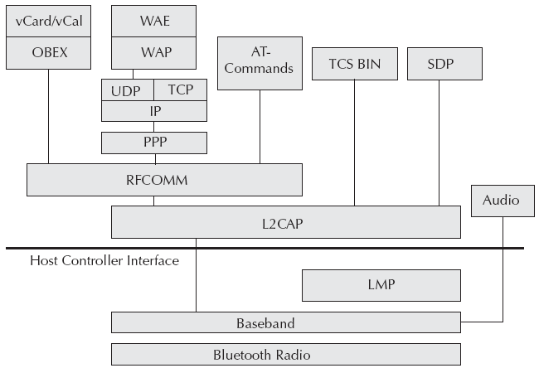
Bluetooth Protocol Stack
OBEX – Object Exchange Protocol TCS BIN – Telephony Control Specification Binary
WAE – Wireless Application Environment SDP – Service Discovery Protocol
WAP – Wireless Application Protocol RFCOMM – Radio Frequency Communication
LMP – Link Manager Protocol L2CAP – Logical Link Control and Adaptation Protocol

Slide 9
Bluetooth Protocol Stack
Bluetooth Core Protocols (Baseband, LMP, L2CAP, SDCAP)
Cable Replacement Protocol (RFCOMM)
Telephony Control Protocols (TCS BIN & AT Commands)
Adopted Protocols (PPP, TCP/IP, OBEX)

Slide 10
Bluetooth Core Protocols
Baseband – enables physical RF link
Link Manager Protocol (LMP) – manages devices in range, power modes, connections, duty cycles, etc.
Logical Link Control and Adaptation Protocol (L2CAP) – segmentation and re-assembly of fragmented packets with their multiplexing
Service Discovery Protocol (SDP) – Enables a device to join a piconet

Slide 11
Cable Replacement Protocol
Radio Frequency Communication (RFCOMM) - emulates RS-232 control and data signals over Bluetooth baseband protocol

Slide 12
Telephony Control Protocols
Telephony Control Specification Binary (TCS BIN) - defines the call control signaling protocol and handles mobility management for groups of Bluetooth TCS devices
Attention (AT) Commands - defines a set of commands by which a mobile phone can be used and controlled as a modem for fax and data transfers

Slide 13
Adopted Protocols
Point-to-Point Protocol (PPP) - means of taking IP packets to/from the PPP layer and placing them onto the LAN
Transmission Control Protocol/Internet Protocol (TCP/IP) - used for communication across the Internet
Object Exchange (OBEX) Protocol - session protocol to exchange objects and used to browse the contents of folders on remote devices
Content Formats - used to exchange messages and notes and synchronize data amongst various devices

Slide 14
Bluetooth Security
Offers security infrastructure starting from authentication, key exchange to encryption
Uses the publicly available cipher algorithm known as SAFER+ to authenticate a device’s identity

Slide 15
Bluetooth Application Models
Each application model in Bluetooth is realized through a Profile. Profiles define the protocols and protocol features supporting a particular usage model. Some common profiles are:
File Transfer
Internet Bridge
LAN Access
Synchronization
Headset

Slide 16
RFID
Radio Frequency Identification
Radio transponder (known as RFID tags) carrying an ID (Identification) can be read through radio frequency (RF) interfaces
Tag is attached to the object and data within the tag provides identification for the object
Object could be an entity in a manufacturing shop, goods in transit, item in a retail store, a vehicle in a parking lot, a pet, or a book in a library

Slide 17
RFID System
Comprises of different functional areas like:
Means of reading or interrogating the
Mechanism to filter some of the data
Means to communicate the data in the tag with a host computer
Means for updating or entering customized data into the tag

Slide 18
RFID Tags
Three basic criteria for categorisation:
Frequency
Application
Power levels

Slide 19
RFID tags based on frequency
Works on six frequencies of 132.4 KHz, 13.56 MHz, 433 MHz, 918 MHz, 2.4 GHz and 5.8 GHz
Low frequency range tags are slow in data transfer and suitable for slow moving objects, security access, asset tracking and animal identification applications
High frequency range tags offer long reading ranges and high data transfer speed and are used for fast moving objects like railway wagon tracking and identification of vehicles on freeways for automated toll collection
Higher the frequency, higher the data transfer rates

Slide 20
RFID tags based on applications
Speed of the object and distance to be read determines the type of tag to be used
RFID systems follow contact-less and non line-of-sight nature of the technology
Tags can be read at high speeds
RFID tag contains two segments of memory - one segment is a factory set and used to uniquely identify a tag while the other one is used by the application
Read/write capability of a RFID system is an advantage in interactive applications such as work-in-process or maintenance tracking

Slide 21
RFID tags based on power levels
Two types - Active and Passive tags
Passive tags are generally in low frequency range
Tags at higher frequency range can be either active or passive

Slide 22
Active Tags
Powered by an internal battery and are typically read/write
Memory can vary from a few bytes to 1MB
Battery supplied power of an active tag generally gives it a longer read range
Greater the size, greater the cost and a limited operational life

Slide 23
Passive Tags
Operate without own power source
Obtains operating power from the reader’s antenna
Data within a passive tag is read only and generally cannot be changed during operation
Lighter, less expensive and offer a virtually unlimited operational life
Have shorter read ranges than active tags and require a high powered reader
Data is usually 32 to 128 bits long

Slide 24
Components of an RFID system
A transponder programmed with unique information (RFID tag)
A transceiver with decoder (a reader)
An antenna or coil
Close proximity passive tags rely on electromagnetic or inductive coupling techniques whereas active tags are based upon propagating electromagnetic waves techniques

Slide 25
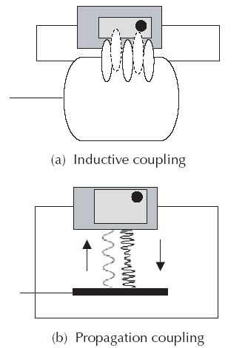
Coupling in Passive and Active RFID tags
(a) Passive RFID tags (b) Active RFID tags

Slide 26
Application areas for RFID
Transportation and Logistics
Manufacturing and Processing
Security
Animal tagging
Retail store and enterprise stores
Community library
Time and attendance
Postal tracking
Airline baggage reconciliation
Road toll management

Slide 27
Wireless Broadband
Also known as Wireless Metropolitan Area Network (Wireless MAN) and Wireless Microwave Access (WiMAX)
IEEE 802.16 standard released in April 2002
Offers an alternative to high bandwidth wired access networks like fiber optic, cable modems and DSL
Provides network access to buildings through exterior antennas communicating with radio base stations
Networks can be created in just weeks by deploying a small number of base stations on buildings or poles to create high capacity wireless access systems

Slide 28
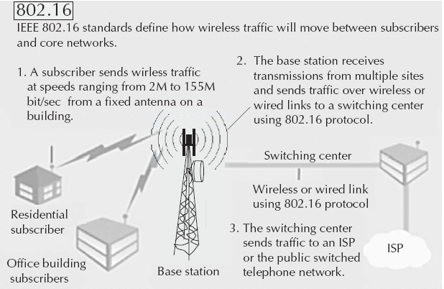
Overview of IEEE 802.16

Slide 29
Sub-standards of IEEE 802.16
IEEE 802.16.1 - Air interface for 10 to 66 GHz
IEEE 802.16.2 - Coexistence of broadband wireless access systems
IEEE 802.16.3 - Air interface for licensed frequencies, 2 to 11 GHz

Slide 30
Basics of IEEE 802.16
IEEE 802.16 standards are concerned with the air interface between a subscriber’s transceiver station and a base transceiver station
The Physical Layer
MAC Layer
Convergence Layer

Slide 31
Physical Layer
Specifies the frequency band, the modulation scheme, error-correction techniques, synchronization between transmitter and receiver, data rate and the multiplexing structure
Both TDD and FDD alternatives support adaptive burst profiles in which modulation and coding options may be dynamically assigned on a burst-by-burst basis
Three physical layer for services: Wireless MAN-SC2, Wireless MAN-OFDM and Wireless MAN-OFDMA

Slide 32
Medium Access Control Layer
Designed for point-to-multipoint broadband wireless access
Addresses the need for very high bit rates, both uplink (to the base station) and downlink (from the base station)
Services like multimedia and voice can run as 802.16 MAC is equipped to accommodate both continuous and bursty traffic

Slide 33
Convergence Layer
Provides functions specific to the service being provided
Bearer services include digital audio/video multicast, digital telephony, ATM, Internet access, wireless trunks in telephone networks and frame relay

Slide 34
Mobile IP
‘Mobile IP’ signifies that, while a user is connected to applications across the Internet and the user’s point of attachment changes dynamically, all connections are maintained despite the change in underlying network properties
Similar to the handoff/roaming situation in cellular network
Mobile IP allows the mobile node to use two IP addresses called home address and care of address
The home address is static and known to everybody as the identity of the host
The care of address changes at each new point of attachment and can be thought of as the mobile node’s location specific address

Slide 35
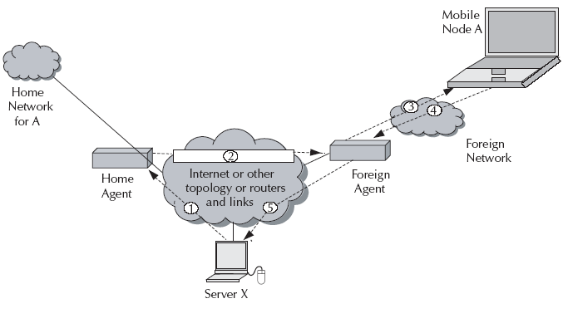
Working of Mobile IP

Slide 36
Working of Mobile IP
Let’s take the case of mobile node (A) and another host (server X). The following steps take place:
Server X wants to transmit an IP datagram to node A. The home address of A is advertised and known to X. X does not know whether A is in the home network or somewhere else. Therefore, X sends the packet to A with A’s home address as the destination IP address in the IP header. The IP datagram is routed to A’s home network.

Slide 37
Working of Mobile IP
At the A’s home network, the incoming IP datagram is intercepted by the home agent. The home agent discovers that A is in a foreign network. A care of address has been allocated to A by this foreign network and available with the home agent. The home agent encapsulates the entire datagram inside a new IP datagram, with A’s care of address in the IP header. This new datagram with the care of address as the destination address is retransmitted by the home agent.
At the foreign network, the incoming IP datagram is intercepted by the foreign agent. The foreign agent is the counterpart of the home agent in the foreign network. The foreign agent strips off the outer IP header, and delivers the original datagram to A.

Slide 38
Working of Mobile IP
A intends to respond to this message and sends traffic to X. In this example, X is not mobile; therefore X has a fixed IP address. For routing A’s IP datagram to X, each datagram is sent to some router in the foreign network. Typically, this router is the foreign agent. A uses X’s IP static address as the destination address in the IP header.
The IP datagram from A to X travels directly across the network, using X’s IP address as the destination address.

Slide 39
Working of Mobile IP
Discovery - A mobile node uses a discovery procedure to identify prospective home agents and foreign agents.
Registration - A mobile node uses a registration procedure to inform its home agent of its care-of address.
Tunneling - Tunneling procedure is used to forward IP datagrams from a home address to a care of address.

Slide 40
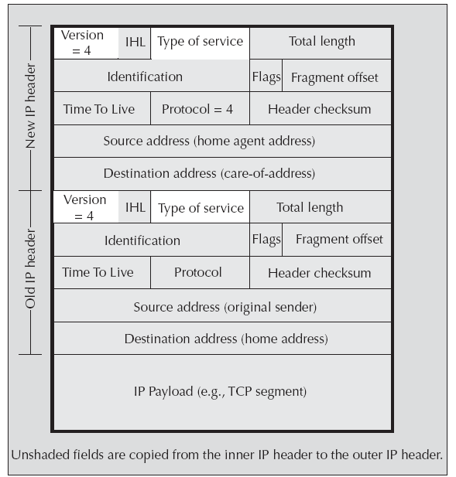
IP headers in Mobile IP

Slide 41
Cellular IP
None of the nodes know the exact location of a mobile host. Packets addressed to a mobile host are routed to its current base station on a hop-by-hop basis where each node only needs to know on which of its outgoing ports to forward packets. This limited routing information (referred as mapping) is local to the node and does not assume that nodes have any knowledge of the wireless network topology. Mappings are created and updated based on the packets transmitted by mobile hosts.

Slide 42
Cellular IP
Uses two parallel structures of mappings through Paging Caches (PC) and Routing Caches (RC)
PCs maintain mappings for stationary and idle (not in data communication state) hosts
RC maintains mappings for mobile hosts
Mapping entries in PC have a large timeout interval, in the order of seconds or minutes. RCs maintain mappings for mobile hosts currently receiving data or expecting to receive data

Slide 43
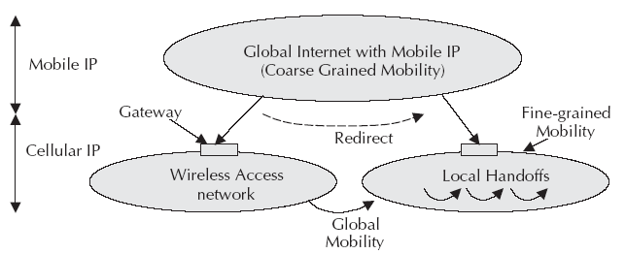
Relationship between Mobile IP and Cellular IP

Slide 44
Internet Protocol version 6
Successor to today’s IP version 4 protocol (IPv4)
Internet Engineering Task Force (IETF) has produced a comprehensive set of specifications (RFC 1287, 1752, 1886, 1971, 1993, 2292, 2373, 2460, 2473, etc.) that define the next-generation IP protocol originally known as ‘IPNg’
Uses 128 bit addresses for each packet creating a virtually infinite number of IP addresses (approximately 3.4*10**38 IP addresses) as opposed to 3758096384 IPv4 addresses

Slide 45
IPv6
There are global addresses and local addresses
Global addresses are used for routing of global Internet
Link local addresses are available within a subnet
IPv6 uses hierarchical addressing with three level of addresses
Includes a Public Topology (the 48 bit external routing prefix)
Site Topology (typically a 16 bit subnet number)
Interface Identifier (typically an automatically generated 64 bit number unique on the local LAN segment)

Slide 46
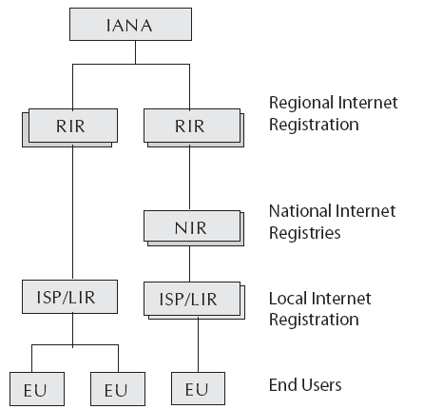
Hierarchical addressing of IPv6

Slide 47
IPv6 Security
Comes native with a security protocol called IP Security (IPSec)
IPSec protocol is a standards-based method of providing privacy, integrity and authenticity to information transferred across IP networks

Slide 48
Features of IPSec
Diffie-Hellman key exchange mechanism for deriving key between peers on a public network
Public key cryptography to guarantee the identity of the two parties and avoid man-in-the-middle attacks
Bulk encryption algorithms, such as 3DES, for encrypting the data
Keyed hash algorithms, such as HMAC, combined with traditional hash algorithms such as MD5 or SHA for providing packet authentication
Digital certificates signed by a certificate authority to act as digital ID cards
IPSec provides IP network layer encryption

Slide 49
Migrating from IPv4 to IPv6
Migration of the network components to be able to support IPv6 packets. Using IP tunneling, IPv6 packets can propagate over an IPv4 envelope. Existing routers can support IP tunneling.
Migration of the computing nodes in the network. This will need the operating system upgrades so that they support IPv6 along with IPv4. Upgraded systems will have both IPv4 and IPv6 stacks.
Migration of networking applications in both client and server systems. This requires porting of the applications from IPv4 to IPv6 environment.

Slide 50
Interconnecting IPv6 networks
Tunneling is one of the key deployment strategies for both service providers as well as enterprises during the period of IPv4 and IPv6 coexistence.
Tunneling service providers can offer an end-to-end IPv6 service without major upgrades to the infrastructure and without impacting current IPv4 services.

Slide 51
Tunneling Mechanisms
Manually created tunnels such as IPv6 manually configured tunnels (RFC 2893)
IPv6 over IPv4 tunnels
Semiautomatic tunnel mechanisms such as that employed by tunnel broker services
Fully automatic tunnel mechanisms such as IPv4 compatible

Slide 52
Mobile IP with IPv6
IPv6 with hierarchical addressing scheme can manage IP mobility much efficiently.
IPv6 also attempts to simplify the process of renumbering which could be critical to the future routing of the Internet traffic.
Mobility Support in IPv6, as proposed by the Mobile IP working group, follows the design for Mobile IPv4. It retains the ideas of a home network, home agent and the use of encapsulation to deliver packets from the home network to the mobile node’s current point of attachment.
While discovery of a care of address is still required, a mobile node can configure its a care of address by using Stateless Address Auto-configuration and Neighbor Discovery. Thus, foreign agents are not required to support mobility in IPv6.

Slide 53
Java Card
Smart card with Java framework
Smart card is a plastic card with intelligence and memory
A smart card is embedded with either (i) a microprocessor and a memory chip or (ii) only a memory chip with non-programmable logic
A microprocessor card can have an intelligent program resident within the card which can add, delete, and otherwise manipulate information on the card
A memory card can store some information for some pre-defined operation

Slide 54
Java Card
Java was chosen as the vehicle for interoperability
All the microprocessor based smart cards now offer Java API framework on the smart card
Java Card technology preserves many of the benefits of the Java programming languages such as productivity, security, robustness, tools, and portability
For Java card, the Java Virtual Machine ( JVM), the language definition, and the core packages have been made more compact to bring Java technology to the resource constrained smart cards

Slide 55
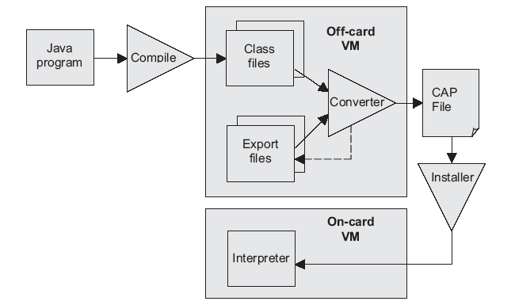
Architecture of Java Card

Slide 56
Functioning of Java Card
Java card technology supports OTA (Over The Air) downloads
Applications written for the Java Card platform are referred to as applets
Challenge of Java Card technology on smart card is to fit Java system software in a resource constraint smart card while conserving enough space for applications
The Java Card virtual machine on a smart card is split into two parts; one that runs off-card and the other that runs on-card

Slide 57
Functioning of Java Card
Many processing tasks that are not constrained to execute at run time, such as class loading, bytecode verification, resolution and linking, and optimization, are dedicated to the virtual machine that is running off-card where resources are usually not a concern
The on-card components of Java Card include components like the Java card virtual machine ( JCVM), the Java card runtime environment ( JCRE), and the Java API
Task of the compiler is to convert a Java source into Java class files
The converter will convert class files into a format downloadable into the smart card while ensuring the byte code validity

Slide 58
Functioning of Java Card
The converter checks the classes off-card for
Well formedness
Java Card subset violations
Static variable initialization
Reference resolution
Byte code optimization
Storage Allocation.
The java card interpreter
Executes the applets
Controls run-time resources
Enforces runtime security

Slide 59
Functioning of Java Card
Following conversion by the off-card VM into CAP (Converted APlet) format, the applet is transferred into the card using the installer
Applet is selected for execution by the JCRE
JCRE is made up of the on-card virtual machine and the Java Card API classes and performs additional runtime security checks through applet firewall
Applet firewall partitions the objects stored into separate protected object spaces, called contexts and controls the access to shareable interfaces of these objects
It is then executed on JVCM which is scaled down version of standard JVM ( Java Virtual Machine)

Slide 60
Next Topic
J2ME
Thank You

